Slide 1
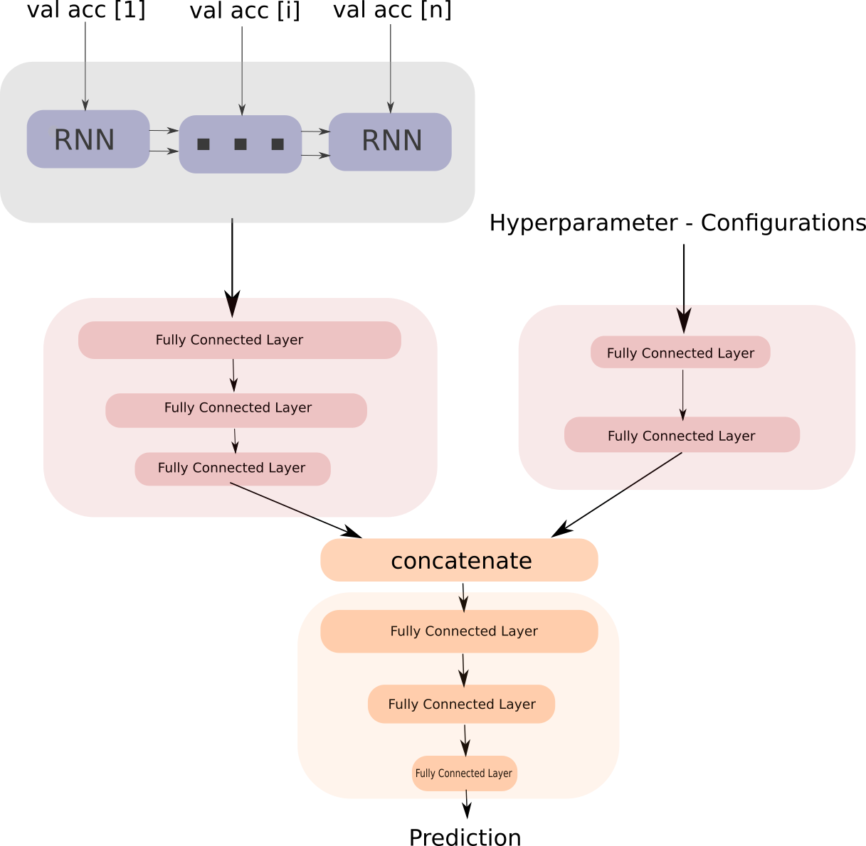
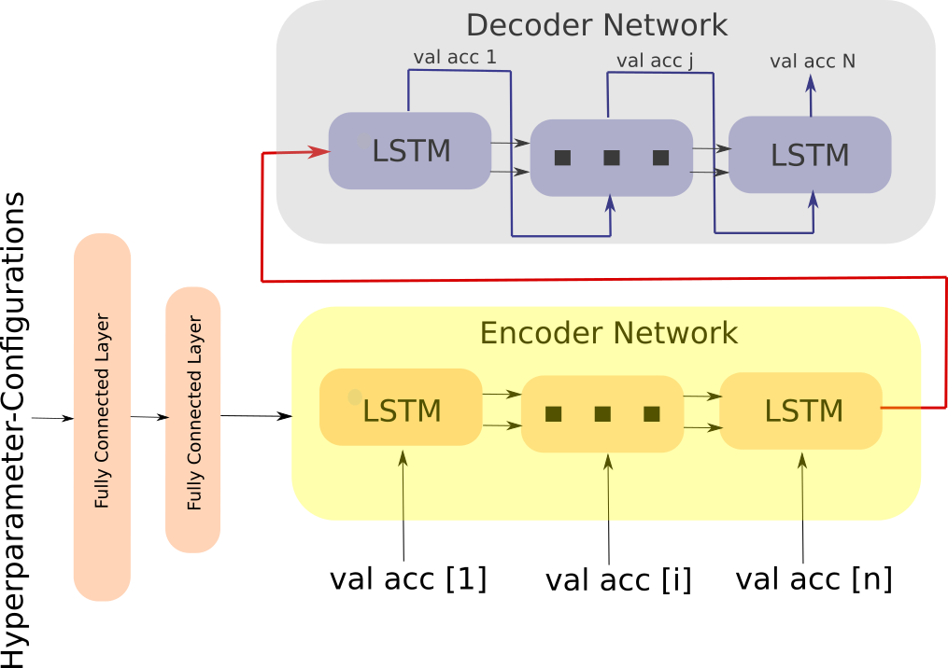
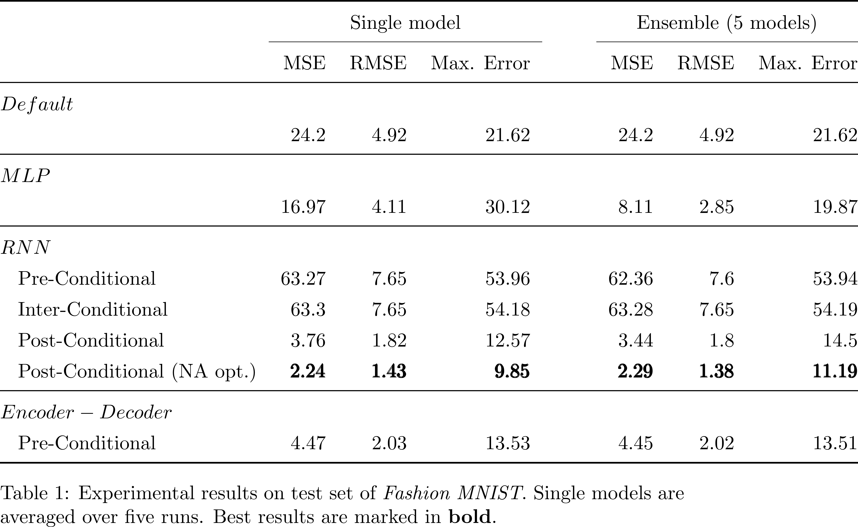
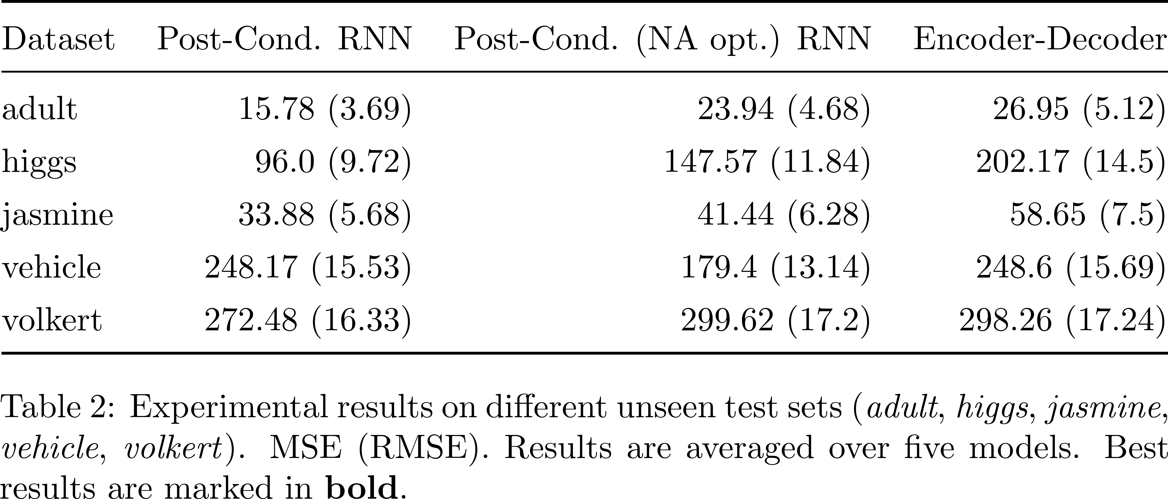
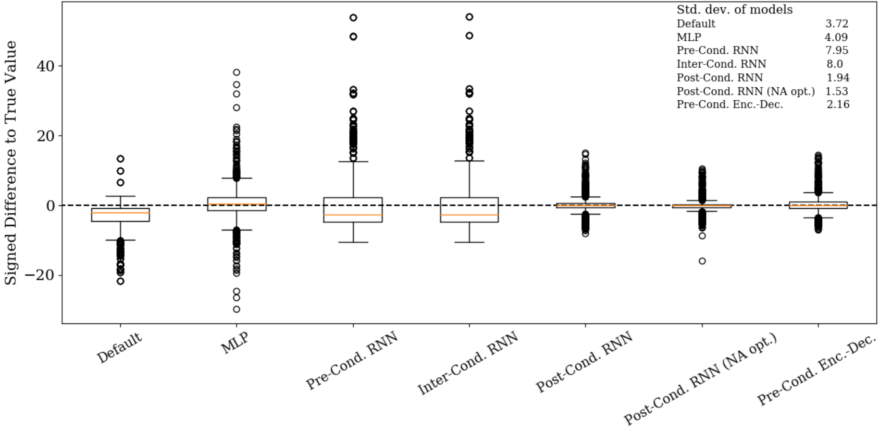
Conditional Performance Prediction Sven Hauns, Sambit Mohapatra & Simon Schrodi
Project goals
Predict validation accuracy at the end of training
Leverage hyperparameter information & sequential data information
Provide reliable fidelities (e.g. learning curve prediction)
Related Work
Parametric learning curve models & partially observed learning curve as input (Domhan et al. 2014)
Bayesian Neural Network using only hyperparameters as input (Klein et al. 2017)
Probabilistic Rollouts, treating learning curves as sequential data & using partially observed learning curves and hyperparameters as input (Gargiani et al. 2019)
Architectures
Pre-Conditional Encoder-Decoder RNN
Post-Conditional RNN
Experimental Results
Outlook & Future Work
Improve generalization capability of models (-> transfer learning)
Visualizing relevancies of hyperparameters
Using multivariate temporal input
Estimate upper and lower bounds of validation accuracy

